Slide 1
FortiGate Security
Introduction to FortiGate and the Security Fabric
FortiOS 6.0.0
Notes:
In this lesson, you will learn about FortiGate administration basics and the components within FortiGate that can be enabled to extend functionality. This lesson also includes how and where FortiGate fits into your existing network architecture and the Security Fabric.

Slide 2
High-Level Features
Setup Decisions
Basic Administration
Built-In Servers
Fundamental Maintenance
FortiGate Within the Security Fabric
Notes:
In this lesson you will explore the following topics:
High-Level Features
Setup Decisions
Basic Administration
Built-In Servers
Fundamental Maintenance
FortiGate Within the Security Fabric

Slide 3
High-Level Features
Identify platform design features of FortiGate
Identify features of FortiGate in virtualized networks and the cloud
Notes:
After completing this section, you should be able to:
Identify platform design features of FortiGate
Identify features of FortiGate in virtualized networks and the cloud
By demonstrating competence in identifying the platform design features of FortiGate, as well as the feature of FortiGate in virtualized networks and the cloud, you will be able to describe the fundamental components of FortiGate and explain the types of tasks that FortiGate can do.

Slide 4
The Modern Context of Network Security
Firewalls are more than gatekeepers on the network perimeter.
Today’s firewalls are designed in response to multi-faceted and multi-device environments with no identifiable perimeter:
Mobile workforce
Partners accessing your network services
Public and private clouds
Internet of things (IoT)
Bring your own device (BYOD)
Firewalls are expected to perform different functions within a network.
Different deployment modes:
Distributed enterprise firewall
Next-generation firewall
Internal segmentation firewall
Data center firewall
DNS, DHCP, web filter, intrusion prevention system (IPS), and so on
Notes:
In the past, the common way of protecting a network was securing the perimeter and installing a firewall at the entry point. Network administrators used to trust everything and everyone inside the perimeter.
Now, malware can easily bypass any entry-point firewall and get inside the network. This could happen through an infected USB stick, or an employee’s compromised personal device being connected to the corporate network. Additionally, because attacks can come from inside the network, network administrators can no longer inherently trust internal users and devices.
What’s more, today’s networks are highly complex environments whose borders are constantly changing. Networks run vertically from the LAN to the Internet, and horizontally from the physical network to a private virtual network and to the cloud. A mobile and diverse workforce (employees, partners, and customers) accessing network resources, public and private clouds, the Internet of Things (IoT), and bring-your-own-device programs all conspire to increase the number of attack vectors against your network.
In response to this highly complex environment, firewalls have become robust multi-functional devices that counter an array of threats to your network. Thus, FortiGate can act in different modes or roles to address different requirements. For example, FortiGate can be deployed as a data center firewall whose function is to monitor inbound requests to servers and to protect them without increasing latency for the requester. Or, FortiGate can be deployed as an internal segmentation firewall as a means to contain a network breach.
FortiGate can also function as DNS and DHCP servers, and be configured to provide web filter, anti-virus, and IPS services.

Slide 5
Platform Design
FortiGuard Subscription Services
• Threat intelligence • Centralized management
FortiClient
Next gen.
firewall
Antivirus
Web
filter
IPS
…
FortiWeb
FortiSandbox
FortiMail
FortiOS
FortiASIC optimized hardware/hypervisor
Integration
Notes:
In the architecture diagram shown on this slide, you can see how FortiGate platforms add strength, without compromising flexibility. Like separate, dedicated security devices, FortiGate is still internally modular. Plus:
Devices add duplication. Sometimes, dedication doesn’t mean efficiency. If it’s overloaded, can one device borrow free RAM from nine others? Do you want to configure policies, logging, and routing on 10 separate devices? Does 10 times the duplication bring you 10 times the benefit, or is it a hassle? For smaller to midsize businesses or enterprise branch offices, unified threat management (UTM) is often a superior solution, compared to separate dedicated appliances.
FortiGate hardware isn’t just off-the-shelf. It’s carrier-grade. Most FortiGate models have one or more specialized circuits, called ASICs, that are engineered by Fortinet. For example, a CP or NP chip handles cryptography and packet forwarding more efficiently. Compared to a single-purpose device with only a CPU, FortiGate can have dramatically better performance. This is especially critical for data centers and carriers where throughput is business critical. (The exception? Virtualization platforms—VMware, Citrix Xen, Microsoft, or Oracle Virtual Box—have general-purpose vCPUs. But, virtualization might be worthwhile because of other benefits, such as distributed computing and cloud-based security.)
FortiGate is flexible. If all you need is fast firewalling and antivirus, FortiGate won’t require you to waste CPU, RAM, and electricity on other features. In each firewall policy, UTM and next-generation firewall modules can be enabled or disabled. Also, you won’t pay more to add VPN seat licenses later.
FortiGate cooperates. A preference for open standards instead of proprietary protocols means less vendor lock-in and more choice for system integrators. And, as your network grows, FortiGate can leverage other Fortinet products such as FortiSandbox and FortiWeb to distribute processing for deeper security and optimal performance—a total Security Fabric approach.

Slide 6
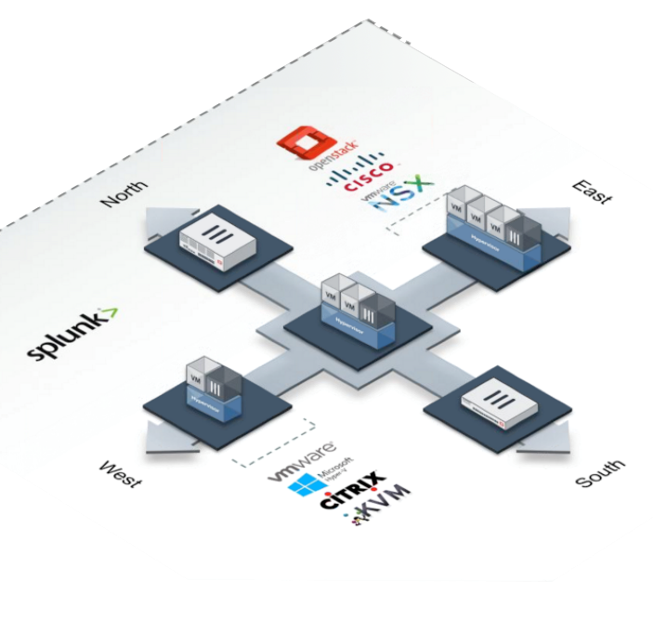

Topology in the Cloud
Deploy FortiGate in virtualized networks
FortiGate VM – Same features as physical appliance except FortiASIC
FortiGate VMX – Subset of features for VMware NSX (east-west) data flows
FortiGate Connector for Cisco ACI – Subset for Cisco ACI (north‑south) data flows. Integrates physical or virtual appliance.
Faster setup and teardown: SDN + VMs
FortiGate VM Specifications
Licenses | Max. 1 / 2 / 4 / 8 vCPU
Hypervisor | VMware, Hyper-V, KVM, Citrix Xen Server, Open Source Xen, Azure, Amazon AWS BYOL & on‑demand
Memory | Max. 1/4/8/12 GB
10/100/1000 Interfaces | 2-4 virtual NICs
Storage Capacity | 40+ GB
FortiGate Connector deployment
FortiGate VMX or VM
Notes:
FortiGate virtual machines (VMs) have the same features as physical FortiGates, except for hardware acceleration. Why? First, the hardware abstraction layer software for hypervisors is made by VMware, Xen, and other hypervisor manufacturers, not by Fortinet. Those other manufacturers don’t make Fortinet’s proprietary FortiASIC chips. But there is another reason, too. The purpose of generic virtual CPUs and other virtual chips for hypervisors is to abstract the hardware details. That way, all VM guest OSs can run on a common platform, no matter the different hardware on which the hypervisors are installed. Unlike vCPUs or vGPUs that use generic, non-optimal RAM and vCPUs for abstraction, FortiASIC chips are specialized optimized circuits. Therefore, a virtualized ASIC chip would not have the same performance benefits as a physical ASIC chip.
If performance on equivalent hardware is less, you may wonder, why would anyone use a FortiGate VM? In large-scale networks that change rapidly and may have many tenants, equivalent processing power and distribution may be achievable using larger amounts of cheaper, general purpose hardware. Also, trading some performance for other benefits may be worth it. You can benefit from faster network and appliance deployment and teardown.
FortiGate VMX and the FortiGate Connector for Cisco ACI are specialized versions of FortiOS and an API that allows you to orchestrate rapid network changes through standards, such as OpenStack for software-defined networking (SDN).
FortiGate VM is deployed as a guest VM on the hypervisor.
FortiGate VMX is deployed inside a hypervisor’s virtual networks, between guest VMs.
FortiGate Connector for Cisco ACI allows ACI to deploy physical or virtual FortiGate VMs for north-south traffic.

Slide 7

High-Level Features
Setup Decisions
Basic Administration
Built-In Servers
Fundamental Maintenance
FortiGate Within the Security Fabric
Notes:
Good job! You now understand some of the high-level features of FortiGate.
Next, you’ll lean how to perform the initial setup of FortiGate and learn about why you might decide to use one configuration over another.

Slide 8
Setup Decisions
Identify the factory defaults
Select an operation mode
Understand FortiGate’s relationship with FortiGuard and distinguish between live queries and package updates
Notes:
After completing this section, you should be able to:
Identify the factory defaults
Select an operation mode
Understand FortiGate’s relationship with FortiGuard and distinguish between live queries and package updates
By demonstrating competence in setting up FortiGate, you will be able to use the device effectively in your own network.

Slide 9
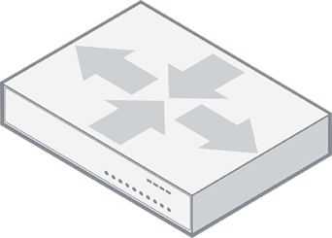
Modes of Operation
NAT
FortiGate is an OSI Layer 3 router
Interfaces have IP addresses
Packets are routed by IP
Transparent
FortiGate is an OSI Layer 2 switch or bridge
Interfaces do not have IPs
Cannot route packets, only forward or block
Notes:
What about the network architecture? Where does FortiGate fit in?
When you deploy FortiGate, you can choose between two operating modes: NAT mode or transparent mode.
In NAT mode, FortiGate routes packets based on layer 3, like a router. Each of its logical network interfaces has an IP address and FortiGate determines the outgoing or egress interface based on the destination IP address and entries in its routing tables.
In transparent mode, FortiGate forwards packets at layer 2, like a switch. Its interfaces have no IP addresses and FortiGate determines the outgoing or egress interface based on the destination MAC address. The device in transparent mode has an IP address used for management traffic.
Interfaces can be exceptions to the router versus switch operation mode, on an individual basis.

Slide 10
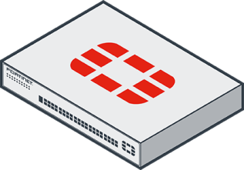


Factory Default Settings
Port1 or internal interface IP: 192.168.1.99/24
PING, HTTP, HTTPS, and SSH protocol management enabled
Built-in DHCP server is enabled on port1 or internal interface
Only on entry-level models that support DHCP server
Default login:
User: admin
Password: (blank)
Both are case sensitive
Modify the default (blank) root password
Can access FortiGate on the CLI
Console: without network
CLI Console widget and terminal emulator, such as PuTTY or Tera Term
Notes:
Network address translation (NAT) mode is the default operation mode. What are the other factory default settings? After you’ve removed FortiGate from its box, what do you do next?
Now you’ll take a look at how you set up FortiGate.
Attach your computer’s network cable to port1 or the internal switch ports (depending on your model). In most entry models, there is a DHCP server on that interface, so, if your computer’s network settings have DHCP enabled, your computer should automatically get an IP, and you can begin setup.
To access the GUI on FortiGate or FortiWifi, open a web browser and go to http://192.168.1.99.
The default login information is public knowledge. Never leave the default password blank. Your network is only as secure as your FortiGate’s admin account. Before you connect FortiGate to your network, you should set a complex password.
All FortiGate models have a console port and/or USB management port. The port provides CLI access without a network. The CLI can be accessed by the CLI Console widget on the GUI or from a terminal emulator, such as PuTTY or Tera Term.

Slide 11



FortiGuard Subscription Services
Internet connection and contract required
Provided by FortiGuard Distribution Network (FDN)
Major data centers in North America, Asia, and Europe
Or, from FDN through your FortiManager
FortiGate prefers data center in nearest time zone, but will adjust by server load
Package updates: FortiGuard Antivirus and IPS
update.fortiguard.net
TCP port 443 (SSL)
Live queries: FortiGuard Web Filtering, DNS Filtering, and Antispam
service.fortiguard.net
Proprietary protocol on UDP port 53 or 8888
Notes:
Some FortiGate services connect to other servers, such as FortiGuard, in order to work. FortiGuard Subscription Services provide FortiGate with up-to-date threat intelligence. FortiGate uses FortiGuard by:
Periodically requesting packages that contain a new engine and signatures
Querying the FDN on an individual URL or host name
Queries are real-time; that is, FortiGate asks the FDN every time it scans for spam or filtered websites. FortiGate queries instead of downloading the database because of the size and frequency of changes that occur to the database. Also, queries use UDP for transport; they are connectionless and the protocol is not designed for fault tolerance, but for speed. So, queries require that your FortiGate has a reliable Internet connection.
Packages, like antivirus and IPS, are smaller and don't change as frequently, so they are downloaded (in many cases) only once a day. They are downloaded using TCP for reliable transport. After the database is downloaded, their associated FortiGate features continue to function even if FortiGate does not have reliable Internet connectivity. However, you should still try to avoid interruptions during downloads—if your FortiGate must try repeatedly to download updates, it can’t detect new threats during that time.

Slide 12
High-Level Features
Setup Decisions
Basic Administration
Built-In Servers
Fundamental Maintenance
FortiGate Within the Security Fabric
Notes:
Good job! You now understand how to perform the initial setup of FortiGate and why you might decide to use one configuration over another. Next, you will learn about basic administration.

Slide 13
Basic Administration
Manage administrator profiles
Manage administrative users
Define the configuration method for administrative users
Control administrative access to the FortiGate GUI and CLI
Manage specific aspects of the network interfaces
Notes:
After completing this lesson, you should be able to:
Manage administrator profiles
Manage administrative users
Define the configuration method for administrative users
Control administrative access to the FortiGate GUI and CLI
Manage specific aspects of the network interfaces
By demonstrating competence in basic administration, you will be able to better manage administrative users and implement stronger security practices around administrative access.

Slide 14
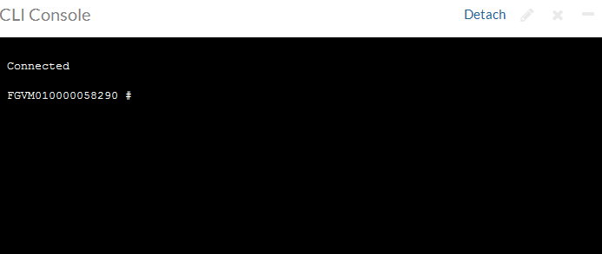


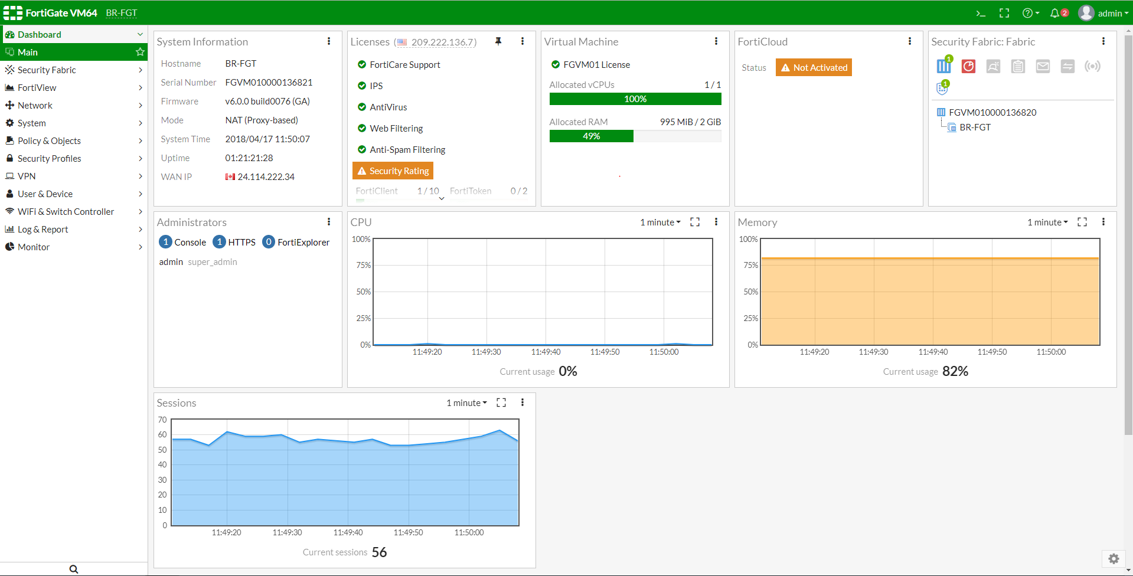
Administration Methods
CLI
Console, SSH, Telnet, GUI Widget
GUI
FortiExplorer, Web Browser (HTTP, HTTPS)
Notes:
Most features are available on both the GUI and CLI, but there are a few exceptions. Reports cannot be viewed on the CLI. Also, advanced settings and diagnostic commands for super users are usually not available on the GUI.
As you become more familiar with FortiGate, and especially if you want to script its configuration, you may want to use the CLI in addition to the GUI. You can access the CLI through either the JavaScript widget in the GUI named CLI Console, or through a terminal emulator such as Tera Term (http://ttssh2.sourceforge.jp/index.html.en) or PuTTY (http://www.chiark.greenend.org.uk/~sgtatham/putty/download.html). Your terminal emulator can connect through the network—SSH or telnet—or the local console port.
SNMP and some other administrative protocols are also supported, but they are read-only. They can’t be used for basic setup.

Slide 15
Basic CLI Commands
Use the following commands to check the system status and list all or only non-default attribute values for an interface.
Use <command set> ? to list commands that you can use with it. For example, get ? And list sub-commands under <command set> <command>. For example, execute backup ?
What to investigate… | CLI commands to Use…
What is the current status of FortiGate? | get system status
What are all the attribute values for the system interface? | show full-configuration system interface <port>
What are the non-default attribute values for the system interface? | show system interface <port>
Notes:
This slide shows some basic CLI commands that you can use to list commands under a command set, check the system status, and list attributes and their values for an interface.

Slide 16
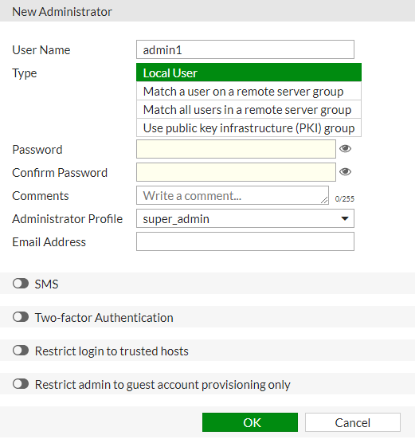
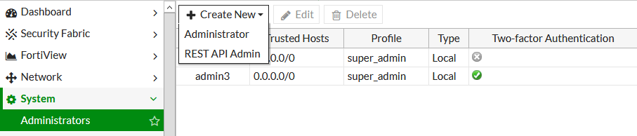
Create an Administrative User
System > Administrators
Notes:
Whichever method you use, start by logging in as admin. Begin by creating separate accounts for other administrators. For security and tracking purposes, it is a best practice for each administrator to have their own account.
In the Create New drop-down list, you can select either Administrator or REST API Admin. Typically, you will select Administrator and then assign an Administrator Profile, which specifies that user’s administrative permissions. You could select REST API Admin to add an administrative user who would use a custom application to access FortiGate with a REST API. The application would allow you to log in to FortiGate and perform any task that your assigned Administrator Profile permits.
Other options not shown here:
Instead of creating accounts on FortiGate itself, you could configure FortiGate to query a remote authentication server.
In place of passwords, your administrators could authenticate using digital certificates that are issued by your internal certification authority server.
If you do use passwords, ensure that they are strong and complex. For example, you could use multiple interleaved words with varying capitalization, and randomly insert numbers and punctuation. Do not use short passwords, or passwords that contain names, dates, or words that exist in any dictionary. These are susceptible to brute force attack. To audit the strength of your passwords, use tools such as L0phtcrack (http://www.l0phtcrack.com/) or John the Ripper (http://www.openwall.com/john/). Risk of a brute force attack is increased if you connect the management port to the Internet.
In order to restrict access to specific features, you can assign permissions.

Slide 17
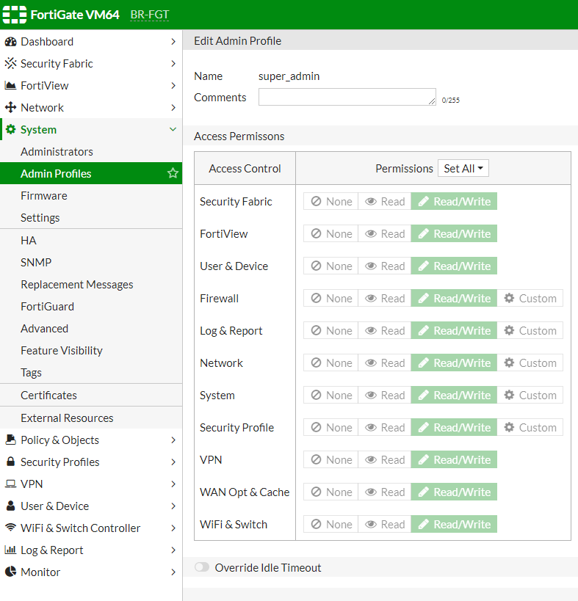

Administrator Profiles: Permissions
System > Admin Profiles
Notes:
When assigning permissions to an administrator profile, you can specify read-and-write, read-only, or none to each area.
By default, there is a special profile named super_admin, which is used by the account named admin. It cannot be changed. It provides full access to everything, making the admin account similar to a root superuser account.
The prof_admin is another default profile. It also provides full access, but unlike super_admin, it only applies to its virtual domain—not the global settings of FortiGate. Also, its permissions can be changed.
You aren’t required to use a default profile. You could, for example, create a profile named auditor_access with read-only permissions. Restricting a person’s permissions to those necessary for his or her job is a best practice, because even if that account is compromised, the compromise to your FortiGate (or network) is not total. To do this, create administrator profiles, then select the appropriate profile when configuring an account.
The Override Idle Timeout feature allows the admintimeout value, under config system accprofile, to be overridden per access profile. Administrator profiles can be configured to increase inactivity timeout and facilitate use of the GUI for central monitoring.
Note that this can be achieved on a per-profile basis, to prevent the option from being unintentionally set globally.

Slide 18
Administrator Profiles: Hierarchy
super_admin
custom_profile1
prof_admin
Full global access
Partial global access
Full access in virtual domain
Partial access in VDOM
custom_profile2
Notes:
What are the effects of administrator profiles?
It’s actually more than just read or write access.
Depending on the type of administrator profile that you assign, an administrator may not be able to access the entire FortiGate. For example, you could configure an account that can view only log messages. Administrators may not be able to access global settings outside their assigned virtual domain either. Virtual domains (VDOMs) are a way of subdividing the resources and configurations on a single FortiGate.
Administrators with a smaller scope of permissions cannot create, or even view, accounts with more permissions. So, for example, an administrator using the prof_admin or a custom profile cannot see, or reset the password of, accounts that use the super_admin profile.

Slide 19
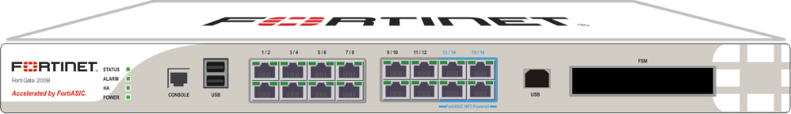
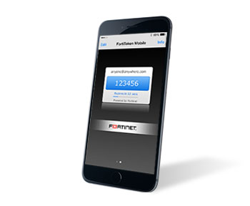

Two-Factor Authentication
Password (one factor)
+
FortiToken (two factor)
Notes:
To further secure access to your network security, use two-factor authentication.
Two-factor authentication means that instead of using one method to verify your identity—typically a password or digital certificate—your identity is verified by two methods. In the example shown on this slide, two-factor authentication includes a password plus an RSA randomly generated number from a FortiToken that is synchronized with FortiGate.

Slide 20
Resetting a Lost Admin Password
User: maintainer
Password: bcpb<serial-number>
All letters in <serial-number> must be upper case, for example, FGT60.
All FortiGate models and some other Fortinet device types
Only after hard power cycle
Soft cycle (reboot) does not work for security reasons.
Only during first 60 seconds after boot (varies by model)
Tip: Copy serial number into the terminal buffer, then paste.
Only through hardware console port
Requires physical access for security reasons.
If compliance/risk of physical access requires, maintainer can be disabled.
config sys global
set admin-maintainer disable
end
Notes:
What happens if you forget the password for your admin account, or a malicious employee changes it?
This recovery method is available on all FortiGate devices and even some non-FortiGate devices like FortiMail. It’s a temporary account, only available through the local console port, and only after a hard reboot—disrupting power by unplugging or turning off the power, then restoring it. FortiGate must be physically shut off, then turned back on, not simply rebooted through the CLI.
The maintainer login will only be available for login for about 60 seconds after boot completes (or less time on older models).
If you cannot ensure physical security, or have compliance requirements, you can disable the maintainer account. Use caution; if you disable maintainer and then lose your admin password, you cannot recover access to your FortiGate. In order to regain access in this scenario, you will need to reload the device. This will reset to factory default.

Slide 21
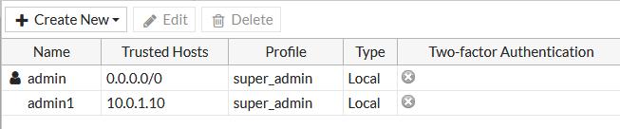
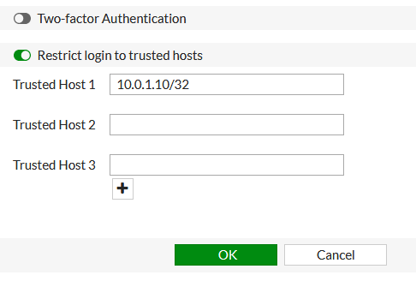
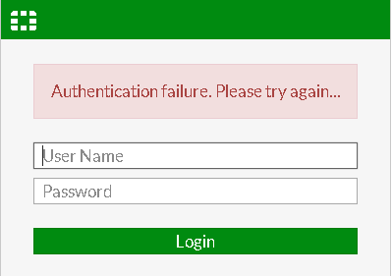
Administrative Access: Trusted Sources
Administrative Access: Trusted Sources
System > Administrators
If admin1 attempts to log in to the FortiGate GUI from any IP other than 10.0.1.10, they receive this message.
Notes:
Another way to secure your FortiGate is to define the hosts or subnets that are trusted sources from which to log in.
In this example, we have configured 10.0.1.10 as the only trusted IP for admin1 from which admin1 log in. If admin1 attempts to log in from a machine with any other IP, they will receive an authentication failure message.
Note: If trusted host are configured on all administrators and an administrator is trying to log in from an IP address that is not set on any of the trusted host for any administrators, then the administrator will not get the login page but rather will receive a message “Unable to contact server”.
If you leave any IPv4 address as 0.0.0.0/0, it means that connections from any source IP will be allowed. By default, 0.0.0.0/0 is the configuration for administrator, although you may want to change this.
Notice that each account can define its management host or subnet differently. This is especially useful if you will be setting up VDOMs on your FortiGate, where the VDOM’s administrators may not even belong to the same organization. Be aware of any NAT that occurs between the desired device and FortiGate. You can easily prevent an administrator from logging in from the desired IP address if it is later NAT’d to another address before reaching FortiGate, thus defeating the purpose of the trusted hosts.

Slide 22
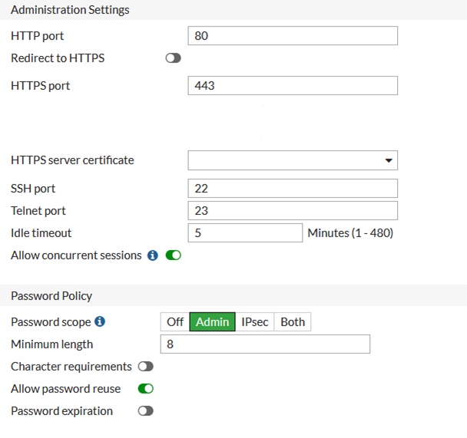
Administrative Access: Ports and Password
Port numbers are customizable.
Using only secure access (SSH, HTTPS) is recommended.
Default Idle timeout is 5 minutes.
System > Settings
Notes:
You may also want to customize the administrative protocols’ port numbers.
You can choose whether to allow concurrent sessions. This can be used to prevent accidentally overwriting settings, if you usually keep multiple browser tabs open, or accidentally leave a CLI session open without saving the settings, then begin a GUI session and accidentally edit the same settings differently.
For better security, use only secure protocols, and enforce password complexity and changes.
The Idle timeout is the number of minutes before an inactive administrator session times out (default is 5 minutes). A shorter idle timeout is more secure, but increasing the timer can help reduce the chance of administrators being logged out while testing changes.
You can override this idle timeout per Administrator profiles, please refer to new feature Override Idle Timeout under Admin Profiles.
Override Idle Timeout - Administrator profiles can be configured to increase inactivity timeout and facilitate use of the GUI for central monitoring. This new feature allows the admintimeout value, under config system accprofile, to be overridden per access profile.
Note that this can be achieved on a per-profile basis, to avoid the option from being unintentionally set globally.

Slide 23
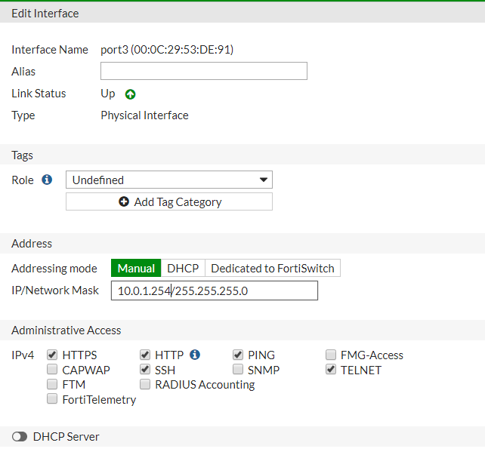
Administrative Access: Protocols
Network > Interfaces
Enable acceptable management protocols on each interface independently:
Separate IPv4 and IPv6
IPv6 options hidden by default
Also protocols where FortiGate is the destination IP:
FortiTelemetry
CAPWAP
FMG-Access
FTM
RADIUS Accounting
Notes:
You’ve defined the management subnet—that is, the trusted hosts—for each administrator account. How do you enable or disable management protocols?
This is specific to each interface. For example, if your administrators connect to FortiGate only from port3, then you should disable administrative access on all other ports. This prevents brute force attempts and also insecure access. Your management protocols are HTTPS, HTTP, PING, SSH. By default, the TELNET option is not visible on the GUI.
Consider the location of the interface on your network. Enabling PING on an internal interface is useful for troubleshooting. However, if it’s an external interface (in other words exposed to the Internet), then the PING protocol could expose FortiGate to a DoS attack. Protocols that do not encrypt data flow, such as HTTP and TELNET, should be disabled. IPv4 and IPv6 protocols are separate. It’s possible to have both IPv4 and IPv6 addresses on an interface, but only respond to pings on IPv6.
Notice that some protocols like FortiTelemetry are not for administrative access, but, like GUI and CLI access, they are protocols where the packets will have FortiGate as a destination IP—and not use FortiGate only as the next hop or bridge. The FortiTelemetry protocol is used specifically for managing FortiClients and Security Fabric. FMG-Access protocol is used specifically for communicating with FortiManager when that server is managing multiple FortiGate devices. The CAPWAP protocol is used for FortiAP, FortiSwitch, and FortiExtender when they are managed by FortiGate. RADIUS accounting protocol is used when FortiGate needs to listen for and process RADIUS Accounting packets for single sign-on authentication. FTM, or FortiToken Mobile push, supports second-factor authentication requests from a FortiToken Mobile app. The Push service is provided by Apple (APNS) and Google (GCM) for iPhone and Android smartphones respectively. In addition, FortiOS supports FTM Push when FortiAuthenticator is the authentication server.

Slide 24
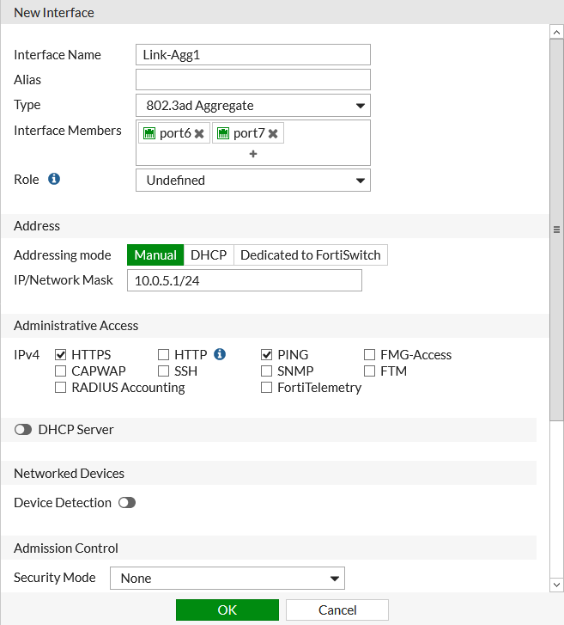
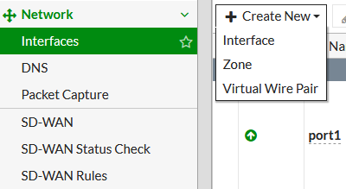
Link Aggregation
Bundles several physical ports to form a single point-to-point logical channel with greater bandwidth.
Increases redundancy for higher availability
Network > Interfaces
Notes:
Link aggregation logically binds multiple physical interfaces into a single channel. Link aggregation increases bandwidth and provides redundancy between two network devices.

Slide 25
High-Level Features
Setup Decisions
Basic Administration
Built-In Servers
Fundamental Maintenance
FortiGate Within the Security Fabric
Notes:
Good job! You now have the knowledge to carry out some basic administrative tasks. Next, you’ll learn about built-in servers.

Slide 26
Built-In Servers
Enable the DHCP service on FortiGate
Enable the DNS service on FortiGate
Understand the configuration possibilities and some of their implications
Notes:
After completing this section, you should be able to:
Enable the DHCP service on FortiGate
Enable the DNS service on FortiGate
Understand the configuration possibilities and some of their implications
By demonstrating competence in implementing the DHCP and DNS built-in servers you will know how to provide these services through FortiGate.

Slide 27
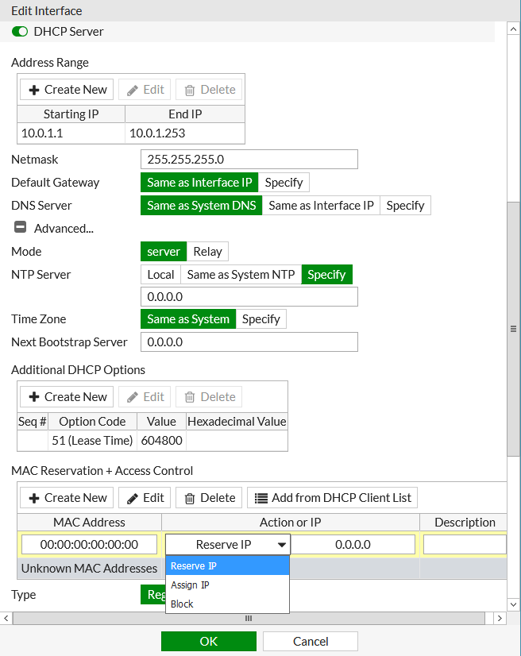
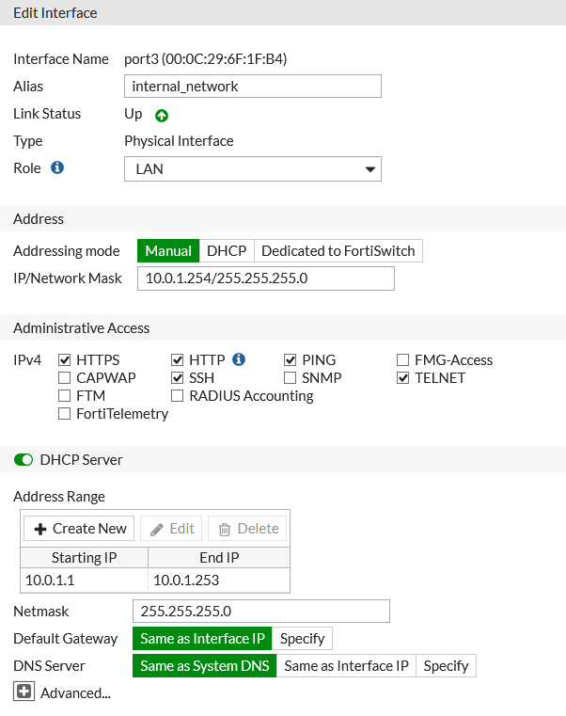
FortiGate as a DHCP Server
Network > Interfaces
Notes:
Wireless clients are not the only ones that can use FortiGate as their DHCP server.
For an interface (such as port3), select the Manual option, enter a static IP, and then enable the DHCP Server option. Options for the built-in DHCP server will appear, including provisioning features, such as DHCP options and MAC reservation. You can also block specific MAC addresses from receiving an IP address. Note that in the screenshot on the right side of the slide, in the MAC Reservation + Access Control section, in the Action or IP column, that the drop-down list provides three options:
Reserve IP: allows you to bind a specific IP to a MAC address.
Assign IP: permits the DHCP server to assign from its pool of addresses to the identified MAC address. A device receiving an IP address will always receive the same address provided that its lease has not expired.
Block: the computer with the identified MAC address and the Block option will not receive an IP address.

Slide 28
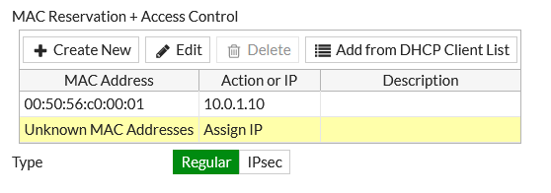
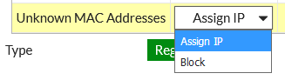
DHCP Server: IP Reservation
Reservations reassign the IP address to the same host.
To reserve, select IP address or choose existing DHCP lease.
Identify reservation as either:
Regular (over Ethernet)
Over IPSec
FortiGate uses the host’s MAC address to look up its IP address in the reservation table.
Actions if MAC is unknown
Network > Interfaces
Notes:
For the built-in DHCP server, you can reserve specific IP addresses for devices with specific MAC addresses.
The action for Unknown MAC Addresses defines what FortiGate's DHCP server will do when it gets a request from a MAC address not explicitly listed.

Slide 29
FortiGate as a DNS Server
Resolves DNS lookups from the internal network
Enabled per interface
Not appropriate for Internet service because of load, and therefore should not be public facing.
One DNS database can be shared by all FortiGate interfaces.
Can be separate per VDOM
Resolution methods:
Forward: relay requests to the next server (in DNS settings).
Non-recursive: use FortiGate DNS database only to try to resolve queries.
Recursive: use FortiGate DNS database first; relay unresolvable queries to next server (in DNS settings).
Notes:
As with DHCP, you can also configure FortiGate to act as your local DNS server. You can enable and configure DNS separately on each interface.
A local DNS server can improve performance for your FortiMail or other devices that use DNS queries frequently. If your FortiGate offers DHCP to your local network, DHCP can be used to configure those hosts to use FortiGate as both the gateway and DNS server.
FortiGate can answer DNS queries in one of three ways:
Forward: relays all queries to a separate DNS server (that you have configured in Network > DNS); that is, acting as a DNS relay instead of a DNS server.
Non-Recursive: replies to queries for items in FortiGate's DNS databases; does not forward unresolvable queries.
Recursive: replies to queries for items in FortiGate's DNS databases; forwards all other queries to a separate DNS server for resolution.
You can configure all modes on the GUI or CLI.

Slide 30
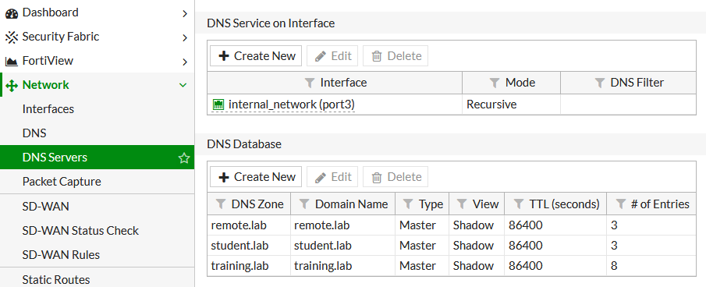
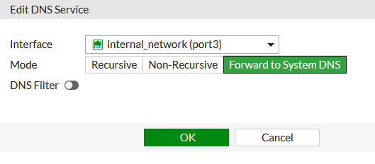
DNS Forwarding
Forwarding allows DNS control without the local FQDN database
Sends query to the external DNS server
Double-click the interface field or select and click Edit.
Network > DNS Servers
To view DNS Servers in Network, you must make it visible in System > Feature Visibility > DNS database.
Notes:
If you choose recursive, FortiGate queries its own database before forwarding unresolved requests to the external DNS servers.
If you choose the DNS forwarding option, you can control DNS queries within your own network, without having to enter any DNS names in FortiGate’s DNS server.

Slide 31
DNS Database: Configuration
Add DNS zones
Each zone has its own domain name
RFC 1034 and1035
Add DNS entries to each zone
Host name
IP address it resolves to
Types supported:
IPv4 address (A) or IPv6 address (AAAA)
Name server (NS)
Canonical name (CNAME)
Mail exchange (MX) server
IPv4 (PTR) or IPv6 (PTR)
Notes:
If you choose to have your DNS server resolve queries, or you choose a split DNS, you must set up a DNS database on your FortiGate.
This defines the host names that FortiGate will resolve queries for. Note that FortiGate currently supports only the DNS record types listed on this slide.

Slide 32
High-Level Features
Setup Decisions
Basic Administration
Built-In Servers
Fundamental Maintenance
FortiGate Within the Security Fabric
Notes:
Good job! You now know how to enable DHCP and DNS services in FortiGate, and have some understanding of configuration possibilities. Next, you will learn about fundamental maintenance.

Slide 33
Fundamental Maintenance
Back up and restore system configuration files
Understand the restore requirements for plain text and encrypted configuration files
Identify the current firmware version
Upgrade firmware
Downgrade firmware
Notes:
After completing this section, you should be able to:
Back up and restore system configuration files
Understand the restore requirements for plain text and encrypted configuration files
Identify the current firmware version
Upgrade firmware
Downgrade firmware
By demonstrating competence in implementing basic maintenance of FortiGate, you will be able to perform the vital activities of back up and restore, and upgrade or downgrade firmware, and ensure that FortiGate remains reliably in service throughout its lifecycle.

Slide 34
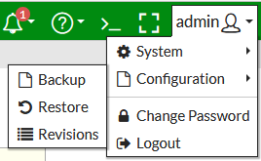
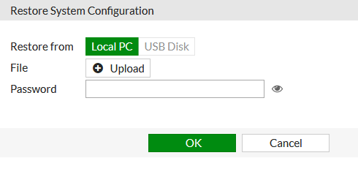
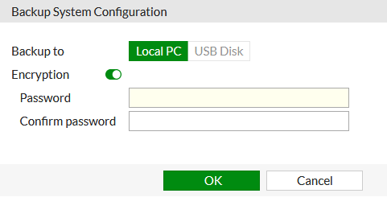
Configuration File: Backup and Restore
Configuration can be saved to an external device
Optional encryption
Can back up automatically
Upon logout
Not available on all models
To restore a previous configuration, upload file.
Reboots FortiGate
Notes:
Now that FortiGate has basic network settings and administrative accounts, you’ll look at how to back up the configuration.In addition to selecting the destination of the backup file, you can choose to encrypt or not to encrypt the backup file. Even if you choose not to encrypt the file, which is the default, the passwords stored in the file are hashed, and, therefore, obfuscated. The passwords that are stored in the configuration file would include passwords for the administrative users and local users, and preshared keys for your IPSec VPNs. It may also include passwords for the FSSO and LDAP servers.
The other option is to encrypt the configuration file with a password. Besides securing the privacy of your configuration, it also has some effects you may not expect. After encryption, the configuration file cannot be decrypted without the password and a FortiGate of the same model and firmware. This means that if you send an encrypted configuration file to Fortinet Technical Support, even if you give them the password, they cannot load your configuration until they get access to the same model of FortiGate. This can cause unnecessary delays when resolving your ticket.
If you enable virtual domains (VDOMs), subdividing the resources and configuration of your FortiGate, each VDOM administrator can back up and restore their own configurations. You don’t have to back up the entire FortiGate configuration, however it is still recommended.
Backups are needed to help speed up the return to production in the event of an unforeseen disaster that damages FortiGate. Having to recreate hundreds of policies and objects from scratch takes a significant amount of time, while loading a configuration file on a new device takes much less.
Restoring a configuration file is very similar to backing one up and reboots the FortiGate.

Slide 35
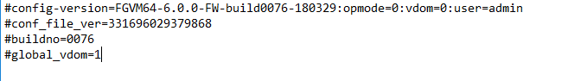

Configuration File Format
Model
Build number
Only non-default and important settings (smaller file size)
Header shows device model and firmware
After the header, the encrypted file is not readable.
Restoring configuration
Encrypted? Same device/model + build + password required.
Unencrypted? Same model required.
Plain text
Build number
Firmware major version
Encrypted
Model
Firmware major version
Notes:
If you open the configuration file in a text editor, you’ll see that both encrypted and unencrypted configuration files contain a clear text header that contains some basic information about the device. The example on this slide shows what information is included.To restore an encrypted configuration, you must upload it to a FortiGate of the same model and firmware, then provide the password.
To restore an unencrypted configuration file, you are required to match only the FortiGate model. If the firmware is different, FortiGate will attempt to upgrade the configuration. This is similar to how it uses upgrade scripts on the existing configuration when upgrading firmware. However, it is still recommended to match the firmware on FortiGate to the firmware listed in the configuration file.
Usually, the configuration file only contains non-default settings, plus few default, yet crucial, settings. This minimizes the size of the backup, which could otherwise be several MB in size.

Slide 36
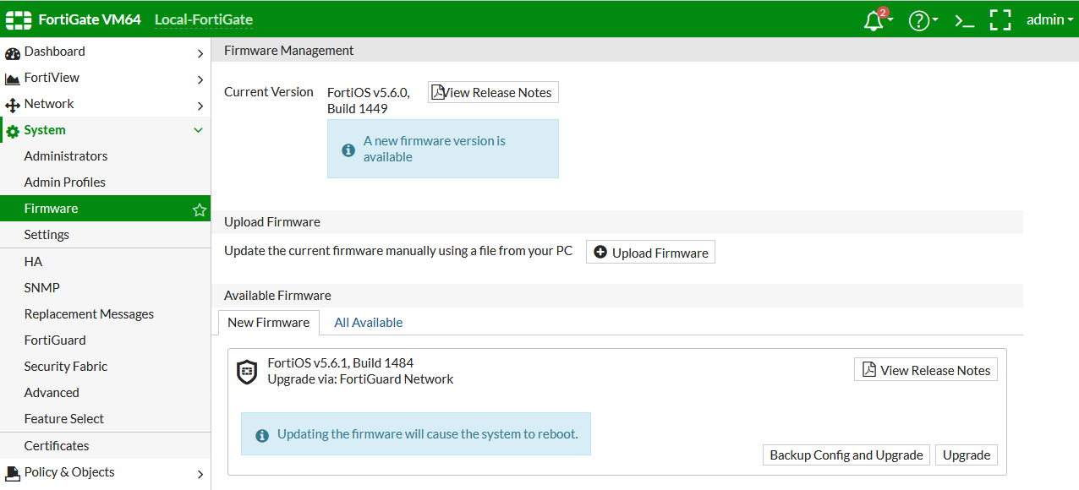
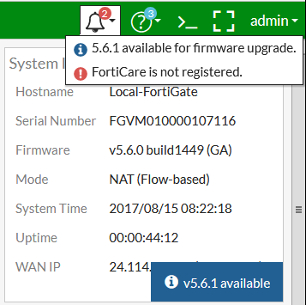
Upgrade Firmware
The current firmware version can be viewed on the Dashboard or in System > Firmware (or on the CLI: get system status).
If there is an updated firmware version, you will be notified.
Firmware can be updated by clicking Upload Firmware or selecting the upgrade option in the notification icon drop-down list.
Make sure you read the Release Notes to verify the upgrade path and other details.
Notes:
You can view the current firmware version in multiple places on the FortiGate GUI. When you first log in to FortiGate, the landing page is the Dashboard. You will see the firmware version in the System widget. This information is also found at System > Firmware. And, of course, you can retrieve the information on the CLI using the command get system status.
If a new version of the firmware is available, you will be notified on the Dashboard and on the Firmware page.
Remember to read the Release Notes to make sure that you understand the supported upgrade path. The Release Notes also provide pertinent information that may affect the upgrade.

Slide 37
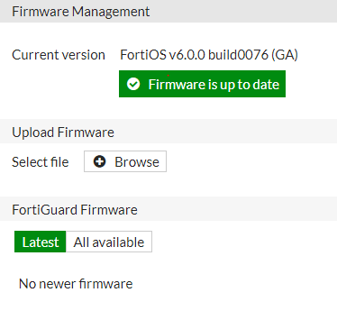
Upgrade Firmware Process
Back up the configuration (full config backup on GUI or CLI).
Download a copy of the current firmware, in case reversion is needed.
Have physical access, or a terminal server connected to local console, in case reversion is needed.
Read the Release Notes; they include the upgrade path and other useful information.
Perform the upgrade.
Notes:
Upgrading the firmware on FortiGate is simple. Click System > Firmware, and then browse to the firmware file that you have downloaded from support.fortinet.com or choose to upgrade online.
If you want to make a clean install by overwriting both the existing firmware and its current configuration, you can do this using the local console CLI, within the boot loader menu, while FortiGate is rebooting. However, this is not the usual method.

Slide 38
Downgrade Firmware Process
Get the pre-upgrade configuration file.
Download a copy of the current firmware, in case reversion is needed.
Have physical access, or a terminal server connected to the local console, in case reversion is needed.
Read the Release Notes. (Does downgrade preserve configuration?)
Downgrade the firmware.
If required, upload the configuration that matches the firmware version.
Notes:
You can also downgrade the firmware. Because settings change in each firmware version, you should have a configuration file in the syntax that is compatible with the firmware.
Remember to read the Release Notes. Sometimes a downgrade between firmware versions that preserves the configuration is not possible, such as when the OS changed from 32-bit to 64-bit. In that situation, the only way to downgrade is to format the disk, then reinstall.
After you’ve confirmed that the downgrade is possible, verify everything again, then start the downgrade. After the downgrade completes, restore a configuration backup that is compatible with that version.
Why should you keep emergency firmware and physical access?
Earlier firmware versions do not know how to convert later configurations. Also, when upgrading through a path that is not supported by the configuration translation scripts, you might lose all settings except basic access settings, such as administrator accounts and network interface IP addresses. Another rare, but possible, scenario is that the firmware could be corrupted when you are uploading it. For all of those reasons, you should always have local console access during an upgrade. However, in practice, if you read the Release Notes and have a reliable connection to the GUI or CLI, it should not be necessary.

